Slide 1
Arrays

Slide 2
Introduction
Array is a data structure which store the data items of the same data type.
We can use normal variables (v1, v2, v3, ..) when we have a small number of objects, but if we want to store a large number of instances, it becomes difficult to manage them with normal variables. The idea of an array is to represent many instances in one variable.

Slide 3
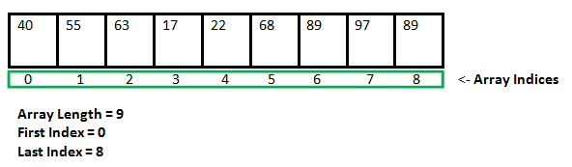
Representation of an Array
For more: https://www.geeksforgeeks.org/arrays-in-c-cpp/

Slide 4
How to declare a array?
To define a array, we need to specify the type of data elements, name and the number of elements(size).
dataType arrayName[arraySize];
int numbers[8];
The above definition reserves 8 elements for integer array.

Slide 5
Using Arrays
Print the element in array.
Print the sum of first three elements in the array.
Add value to a element

Slide 6
Defining and initializing an array
#include <stdio.h>
int main(void){
int n[5];
int i;
for(i = 0; i < 5; i++){
n[i] = 0;
}
for(i = 0; i < 5; i++){
printf(“%d %d”, i, n[i]);
}
return 0;
}

Slide 7
Initializing array using an initializer list
#include <stdio.h>
int main(void){
int n[5] = {4, 7, 1, 3 , 9};
// int n[] = {4, 7, 1, 3 , 9};
// int [5] = {0};
int i;
for(i = 0; i < 5; i++){
printf(“%d %d”, i, n[i]);
}
return 0;
}

Slide 8
Summing the Elements of an Array
#include <stdio.h>
#define SIZE 12
int main(void){
int a[SIZE];
int i;
int total = 0;
for(i = 0; i < SIZE; i++){
printf(“a[%d]: ”, i);
scanf(“%d”, &a[i]);
}
for(i = 0; i < SIZE; i++){
total += a[i];
}
printf(“%d”, total);
}

Slide 9
Exercise 1
Write a c program to the following.
Define an integer array counts with 10 elements.
Initialize all elements to zeros.
Read and store 10 numbers each of which is between 10 and 100
Find the maximum number from the stored numbers.

Slide 10
Storing String in a Character Array
A string can be stored in a character array as follows:
char string1[] = “first”;
char string1[] = {‘f’, ‘i’, ‘r’, ‘s’, ‘t’, ‘\0’};
Function scanf will read characters until space, tab, newline or end-of-file indicator is encountered.
'\0' is string terminator
Get string with spaces
scanf("%[^\n]s",str);
You don’t need to use ‘&’ when you get string as input
https://www.geeksforgeeks.org/not-used-strings-scanf-function/

Slide 11
Display Character String
printf(“string1 is : %s\n”, string1);
for ( i= 0; i < SIZE && string1 [ i ] != ‘\0’; ++i){
printf(“%c”, string1[ i ]);
}

Slide 12
Passing String to a Function
#include <stdio.h>
void displayString(char str[]);
int main(void){
char str[50];
printf("Enter string: ");
scanf(“%s”, str);
displayString(str); // Passing string to a function.
return 0;
}
void displayString(char str[])
{
printf("String Output: ");
puts(str);
}

Slide 13
Function strcpy
# include < stdio.h>
# include <string.h>
#define SIZE1 25
int main ( void ) {
char x[ ]= ‘Happy Birthday to You”;
char y[ SIZE1];
strcpy( y , x );
printf(“The string in array y is : %s\n”, y);
return 0;
}

Slide 14
Function strlen
strlen takes a string as an argument and return the number of characters in the string.
#include <string.>
#include <stdio.h>
int main(){
char string1[] = “I Love C Programming!”;
printf(“The length of string1: %d”, strlen(string1));
return 0;
}

Slide 15
Passing Array to Function
// Program to calculate the sum of array elements by passing to a function
#include <stdio.h>
float calculateSum(float num[]);
int main(void) {
float result, num[] = {23.4, 55, 22.6, 3, 40.5, 18};
// num array is passed to calculateSum()
result = calculateSum(num);
printf("Result = %.2f", result);
return 0;
}
float calculateSum(float num[]) {
float sum = 0.0;
for (int i = 0; i < 6; ++i) {
sum += num[i];
}
return sum;
}

Slide 16
Multi Dimensional Array
C language have arrays with multiple subscripts.
These arrays are refers to as multidimensional arrays.
Multidimensional arrays are used to represent table of values consisting of information arranged in rows and columns.
A array with two subscripts is called double-subscripted or Two-Dimensional array.

Slide 17
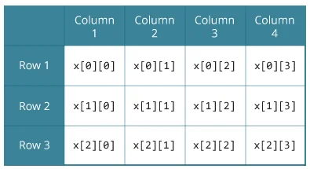
Two Dimensional Array
Array name
Row index
Column index

Slide 18
Define and Initialize 2D Array
Different ways to initialize 2d array.
int c[2][3] = {{1, 3, 0}, {-1, 5, 9}};
int c[][3] = {{1, 3, 0}, {-1, 5, 9}};
int c[2][3] = {1, 3, 0, -1, 5, 9};

Slide 19
Let’s try to get sum of a 2D array!

Slide 20
Array of Structures

Slide 21
Summary
1D array
String
Passing array to function
2D array
Array of structures

